Slide 1
Schema refinement: Normalisation

Slide 2
Decomposing relations
we saw that we could ‘decompose’ the bad relation schema
Data(sid,sname,address,cid,cname,grade)
to a ‘better’ set of relation schema
Student(sid,sname,address)
Course(cid,cname)
Enrolled(sid,cid,grade)

Slide 3
Are all decompositions good?
Consider an example:
Data(sid,sname,address,cid,cname,grade)
Alternatively we could decompose into
R1(sid,sname,address)
R2(cid,cname,grade)
But this decomposition loses information about the relationship between students and courses

Slide 4
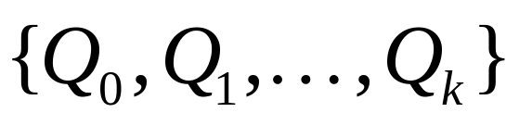
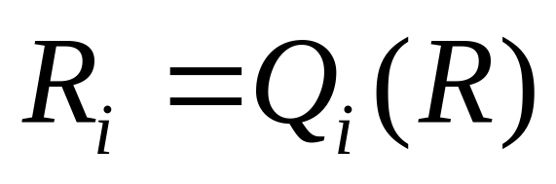
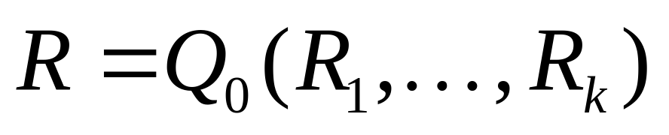
Decomposition
A decomposition of a relation R=R(A₁:τ₁, …, A_{n}:τ_{n}) is a collection of relations {R₁, …, R_{k}} and a set of queries
such that
if
then

Slide 5
Special Case: Lossless-join decomposition
{R₁,…,R_{k}} is a lossless-join decomposition of R with respect to an FD set F, if for every relation instance r of R that satisfies F,
π_{R1}(r) V … V π_{Rk}(r) = r
(this means project on the attributes of the relation’s schema)

Slide 6
Lossless-join: Example 2
A | B
1 | 2
4 | 5
7 | 2
Lossless-join?
A | B | C
1 | 2 | 3
4 | 5 | 6
7 | 2 | 8
B | C
2 | 3
5 | 6
2 | 8

Slide 7
Lossless-join: Example
sid | sname | address | cid | cname | grade
124 | Julia | USA | 206 | Database | A++
204 | Kim | Essex | 202 | Semantics | C
124 | Julia | USA | 201 | S/Eng I | A+
206 | Tim | London | 206 | Database | B-
124 | Julia | USA | 202 | Semantics | B+
What happens if we decompose on
(sid,sname,address) and (cid,cname,grade)?

Slide 8
Dependency preservation
Intuition: If R is decomposed into R₁, R₂ and R₃, say, and we enforce the FDs that hold individually on R₁, on R₂ and on R₃, then all FDs that were given to hold on R must also hold
Reason: Otherwise checking updates for violation of FDs may require computing joins

Slide 9
Dependency preservation
The projection of an FD set F onto a set of attributes Z, written F_{z} is defined
{X→Y | X→Y∈F⁺ and X∪Y⊆Z}
A decomposition ρ={R₁,…,R_{k}} is dependency preserving if
F⁺=(F_{R1} ∪ … ∪ F_{Rk})⁺
GOAL OF SCHEMA REFINEMENT: REDUCE REDUNDANCY
WHILE PRESERVING DEPENDENCIES IN A LOSSLESS-JOIN
MANNER.

Slide 10
Dependency preservation: example
Take R=R(city, street&no, zipcode) with FDs:
  city,street&no → zipcode
  zipcode → city
Decompose to
  R1(street&no,zipcode)
  R2(city,zipcode)
Claim: This is a lossless-join decomposition
Is it dependency preserving?

Slide 11
Boyce-Codd normal form
“Represent Every Fact Only ONCE”
A relation R with FDs F is said to be in Boyce-Codd normal form (BCNF) if for all X→A in F⁺ then
  Either A∈X (‘trivial dependency’), or
  X is a superkey for R
Intuition: A relation R is in BCNF if the left side of every non-trivial FD contains a key

Slide 12
BCNF: Example
Consider R=R(city, street&no, zipcode) with FDs:
  city,street&no → zipcode
  zipcode → city
This is not in BCNF, because zipcode is not a superkey for R
  We potentially duplicate information relating zipcodes and cities

Slide 13
BCNF: Example
BankerSchema(brname,cname,bname)
With FDs
  bname → brname
  brname,cname → bname
Not in BCNF (Why?)
We might decompose to
  BBSchema(bname,brname)
  CBrSchema(cname,bname)
This is in BCNF ☺
BUT this is not dependency-preserving ☹

Slide 14
Third normal form
A relation R with FDs F is said to be in third normal form (3NF) if for all X→A in F⁺ then
  Either A∈X (‘trivial dependency’), or
  X is a superkey for R, or
  A is a member of some candidate key for R
Notice that 3NF is strictly weaker than BCNF
(A prime attribute is one which appears in a candidate key)
It is always possible to find a dependency-preserving lossless-join decomposition that is in 3NF.

Slide 15
3NF: Example
Recall R=R(city, street&no, zipcode) with FDs:
  city,street&no → zipcode
  zipcode → city
We saw earlier that this is not in BCNF
However this is in 3NF, because city is a member of a candidate key ({city,street&no})

Slide 16
Prehistory: First normal form
First normal form (1NF) is now considered part of the formal definition of the relational model
It states that the domain of all attributes must be atomic (indivisible), and that the value of any attribute in a tuple must be a single value from the domain
NOTE: Modern databases have moved away from this restriction

Slide 17
Prehistory: Second normal form
A partial functional dependency X→Y is an FD where for some attribute A∈X, (X-{A})→Y
A relation schema R is in second normal form (2NF) if every non-prime attribute A in R is not partially dependent on any key of R

Slide 18
Summary: Normal forms
1NF
2NF
3NF
BCNF

Slide 19
Not the end of problems…
ONLY TRIVIAL FDs!! (see Date)
Is in BCNF!
Obvious insertion anomalies…
Course | Teacher | Book
Databases | gmb | Date
Databases | gmb | Elmasri
Databases | jkmm | Date
Databases | jkmm | Elmasri
OSF | gmb | Silberschatz
OSF | tlh | Slberschatz

Slide 20
Decomposition
Even though its in BCNF, we’d prefer to decompose it to the schema
  Teaches(Course,Teacher)
  Books(Course,Title)
We need to extend our underlying theory to capture this form of redundancy

Slide 21
Further normal forms
We can generalise the notion of FD to a ‘multi-valued dependency’, and define two further normal forms (4NF and 5NF)
In practise, BCNF (preferably) and 3NF (at the very least) are good enough

Slide 22
Design goals: Summary
Our goal for relational database design is
  BCNF
  Lossless-join decomposition
  Dependency preservation
If we can’t achieve this, we accept
  Lack of dependency preservation, or
  3NF

Slide 23
Summary
You should now understand:
Decomposition of relations
Lossless-join decompositions
Dependency preserving decompositions
BCNF and 3NF
2NF and 1NF

